Slide 1
RC & Ardupilot

Slide 2
ArduPilot Firmware
Firmware that runs on Flight Controller Hardware
Used for GPS-based autonomous (or semi-autonomous) flights
PX4 is an alternative but harder to use
Different versions: ArduPlane, ArduCopter, ArduRover, ArduSub, etc.

Slide 3
Types of Flight Controller Hardware
Standard ‘PixHawk style’ has same connectors, so peripherals plug in easily
RadioLink PixHawk – probably best quality, but many knock-offs
RadioLink versions actually have 'RadioLink' printed on them
RadioLink version works with
Predessor was called APM
CubePilot Orange+ Cube
HolyBro
PixHawk 6X standard set $325
PixHawk 6C mini $
Matek Wing Boards
Omnibus
Linux-Based
3rd party hardware that does not look like the PixHawk-style

Slide 4
Pixhawk Flight Controller
This is a ‘style’ of controller with standard connectors
I have a PixHawk v2.4.8 but NOT a Cube
Stuff that needs to be plugged in:
Receiver / Antenna
Servos
Telemetry – get in-flight real-time data back to controller
GPS / GNSS (supports GPS, BDS, GLONASS, GALILEO, QZSS, IRNSS)
Battery voltage adapter to Pixhawk-friendly voltages
IMU (Inertial Measurement Units): accelerometers / gyroscopes / magnetometers
Altitude: Barometer
Air speed sensor
Camera
Lidar
Buzzer for feedback
Connect via microUSB cable and hit ‘Connect’ button from Mission Planner
&& sshclient.IsConnected

Slide 5
Alternative to using MissionPlanner on Pi to just get telemetry data from PixHawk
You can get telemetry data directly through the serial port on the PixHawk
this works with the RadioLink PixHawk but maybe not with knock-offs
Use DroneKit python library to connect to PixHawk & interpret data
DroneKit github:
My version: C:\p\embedded\RaspberryPi\PixHawk\dronekit_joes
dronekit_check_attitude.py just continually gets telemetry data
Types of telemetry data you can get:
GPS location
Battery percent
Attitude: roll, pitch and yaw
Velocity / Ground speed / Air speed
Gimbal status
Armed yes/no

Slide 6
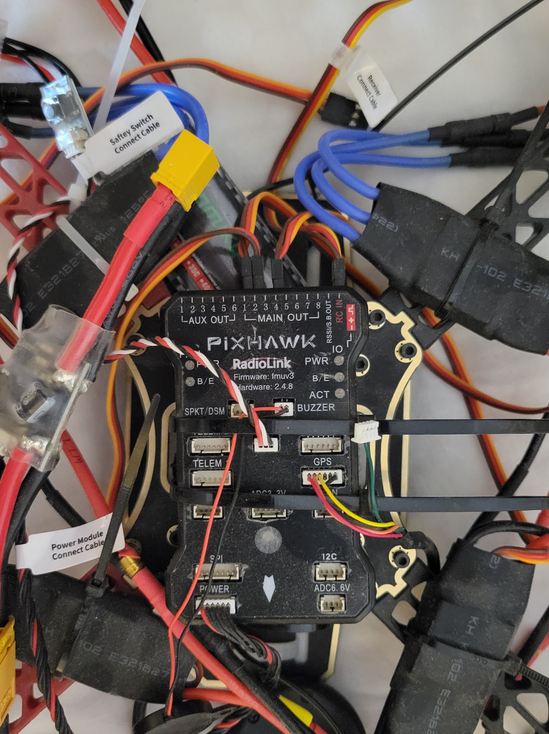
RadioLink PixHawk v2.4.8
Firmware FMUv3
Connect to a receiver to also
control via joystick controller
To motor ESCs / servos
Power regulator
to give PixHawk-friendly
voltage
To GPS / GNSS ‘dome’
Buzzer for feedback

Slide 7
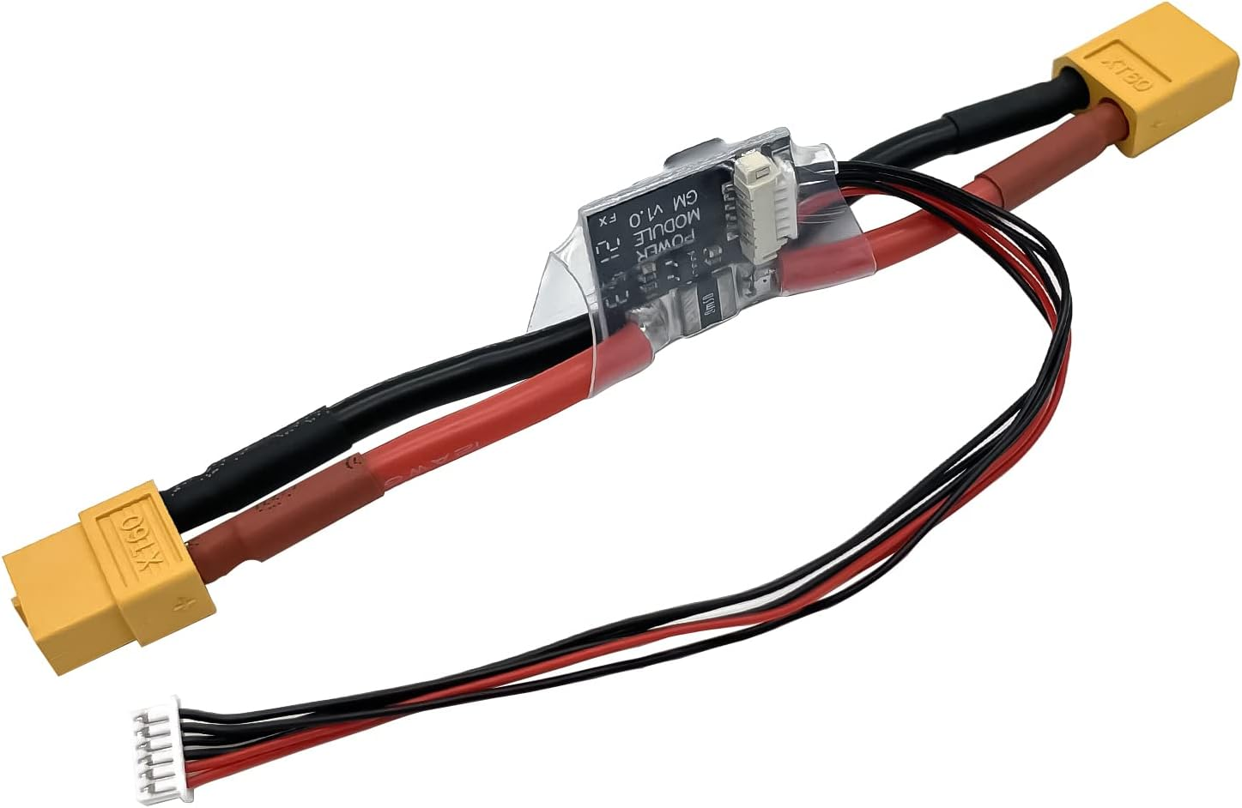
Power Adapter so Lipo battery can power the PixHawk as well as the motors (also available in XT60 style plug)

Slide 8
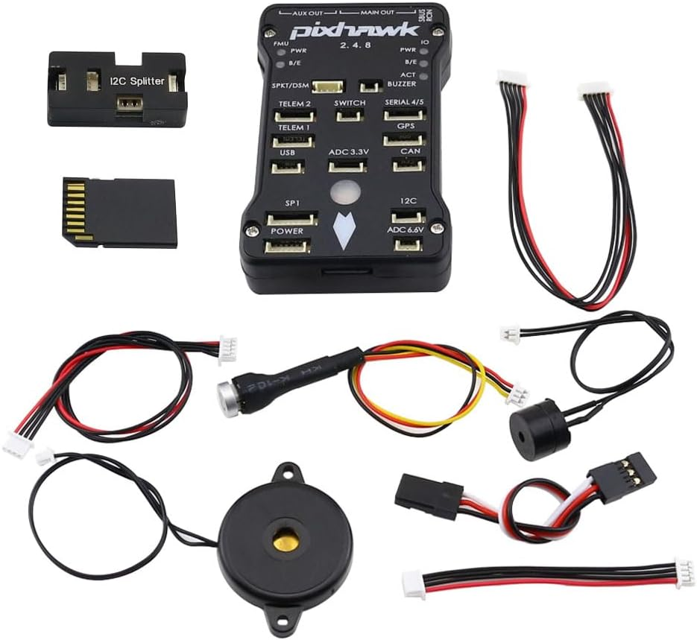
PixHawk accessories
6-pin connector adapter, can also
get version that splits into single
wires to hookup serial connection
to Pi or Nvidia Nano.
Safety button to turn
on/off motors or 'arm‘ it.
Buzzer for audio feedback such
as when it’s 'armed'.
Servo cable.

Slide 9
CubePilot Cube
Cube plugs into something that looks like PixHawk but actually says CubePilot on it as well
Orange+ is latest & greatest $350
Cheaper mini purple version for ground vehicles
Original version of Cube was black and called a ‘PixHawk 2.1’ but the named changed to just ‘Cube’

Slide 10
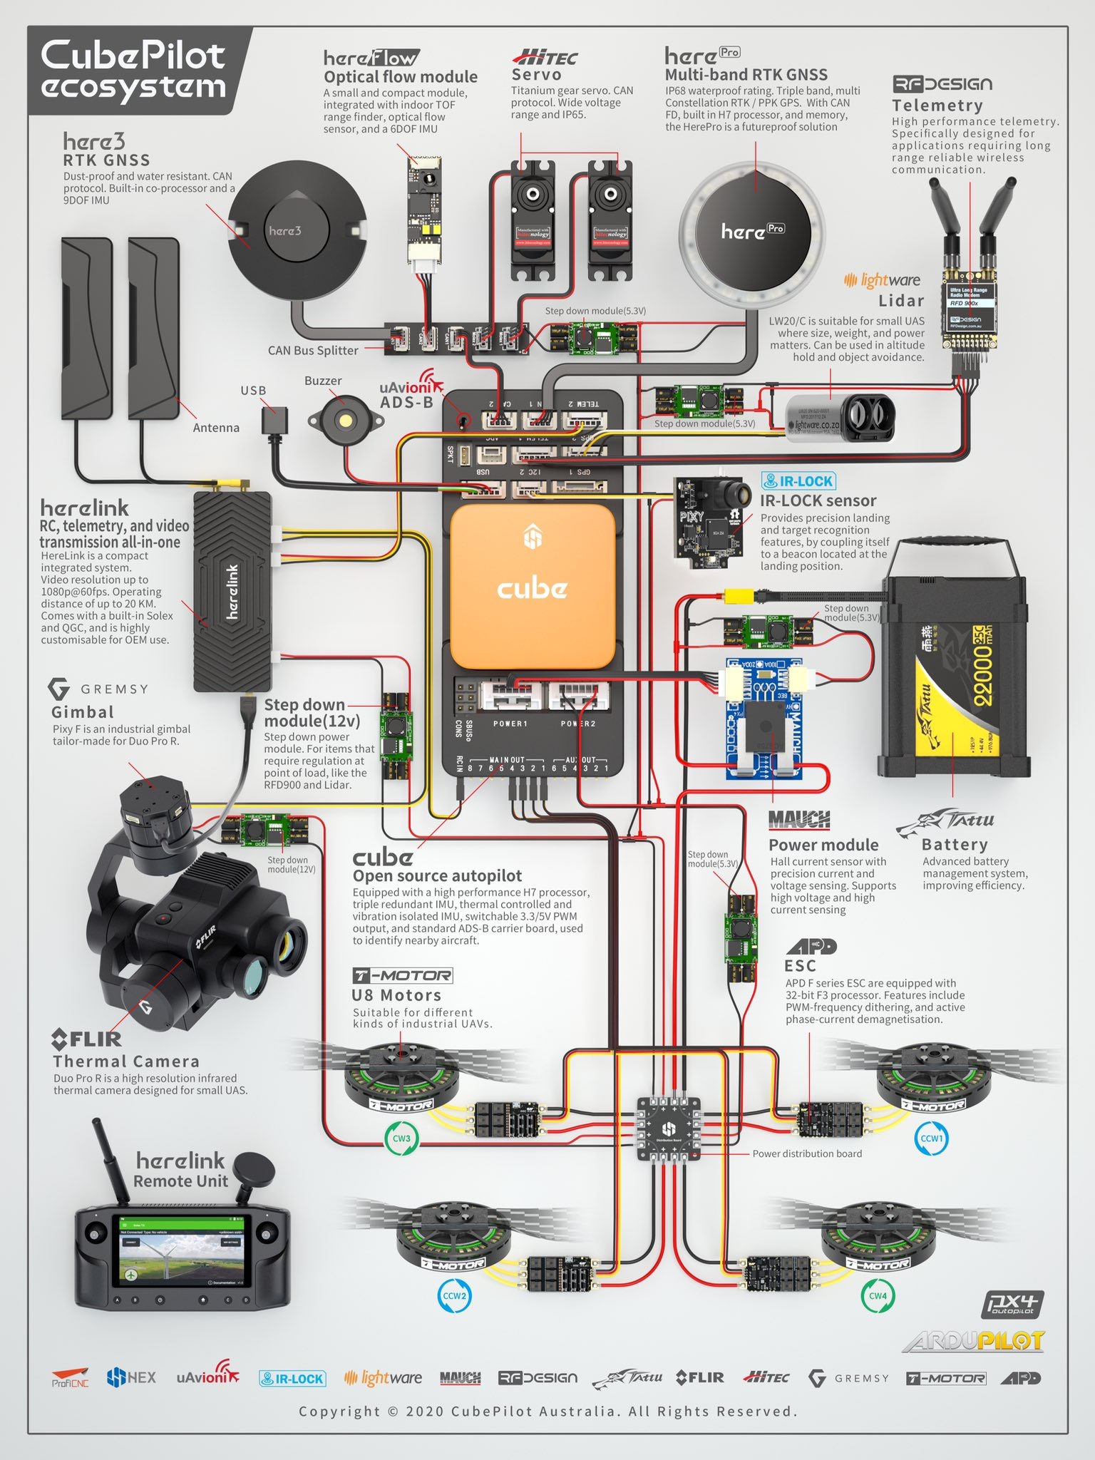
CubePilot Cube Orange+

Slide 11
Ground Control Software
Mission Planner is most popular and easiest, but also:
QGroundControl
APM Planner 2
could also run app from phone or tablet
Used to flash firmware onto the flight controller hardware
Used to monitor flight and control vehicle remotely
Can use in combination with a joystick-type controller, but it’s possible to have no controller at all. The point is an autonomous flight plan, anyways.
Can stop the flight and call back to home, etc.

